Slide 1
Business Services Authority
Electronic Staff Record
Apprenticeships in ESR
Apprentice details can be recorded in ESR to identify the employees that are on apprenticeship schemes, their status and relevant dates.
The principle of including the information that is currently held is to ensure accurate recording of the apprenticeship details that is required to satisfy national reporting requirements for public sector organisations as well as enabling local monitoring of this data.
The Assignment EIT (Extra Information Type) has been included in both the Generic Inbound and Outbound Interfaces and has been included in the IAT Portable Data Set Copy and all rows (where applicable) will be transferred from the Source to the Target Employing Authority.
Link to User Manual:
Enter and Maintain Apprenticeship
Details
v1.0 06Feb24

Slide 2
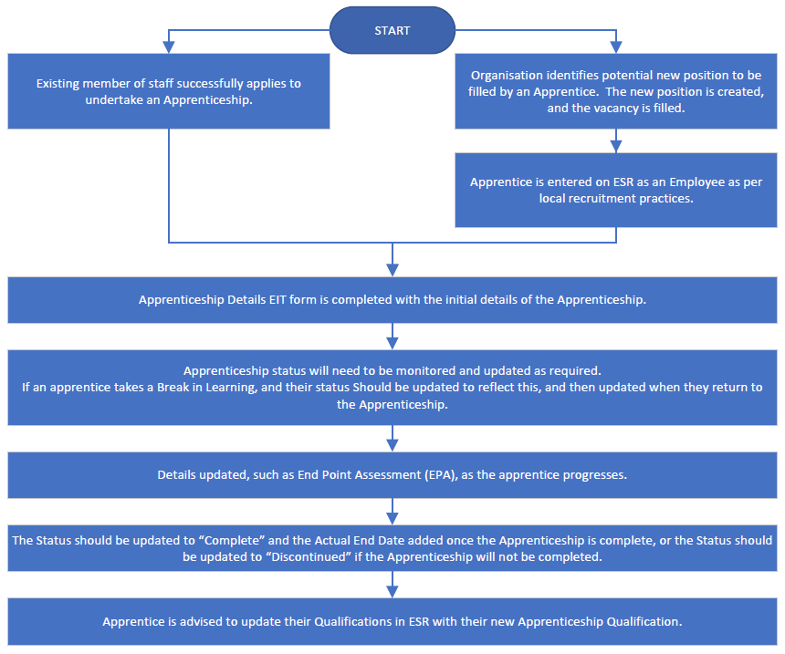
₂
Process Flow for of Recording Apprenticeships in ESR

Slide 3
₃
The Benefits of Recording Apprenticeships in ESR
Holding apprenticeship information within ESR enables the data to be linked to further workforce information and enables significant reporting potential, for example:
Equality characteristics
Salary information
Reason for Leaving
Future career (i.e. progression following completion of Apprenticeship)
Information will be transferred through the IAT process enabling organisations to inherit historical apprenticeship details for a new employee.
National bodies will be able to report on NHS apprentice information through ESR, reducing the burden on organisations to provide this data via separate systems and submissions.
Using the EIT form allows you to record apprenticeship details to sit alongside an individual’s employment information, which records a position that is relevant to the work being undertaken by the apprentice
It is now possible to report on employees who have been specifically employed as an apprentice as well as those employees who are undertaking an apprenticeship whilst continuing in their existing post. These scenarios will be differentiated by the ‘Apprentice Type’ field.
Organisations can utilise ESR Business Intelligence (BI)
to assist in meeting the statutory reporting
requirements, in relation to apprenticeships, set out by the Department for Education. This includes the need to report on apprentices as a proportion of your
overall trust headcount.

Slide 4
₄
Who can access Apprenticeship Details?
The following User Responsibility Profiles (URPs) can access Apprenticeship Details:
Learning Administration URP* > Manage Learners > Apprenticeship Details
HR and Payroll URPs > Fastpath > Assignment Extra Information
Recruitment URPs > Fastpath > Apprenticeship Details
* Smartcard may not be required if this is the only professional URP held
Manager/Supervisor/Administrator Self-Service can see the Staff in Post Dashboard in Business Intelligence which gives them access to all the reports with the information restricted to their hierarchy.

Slide 5
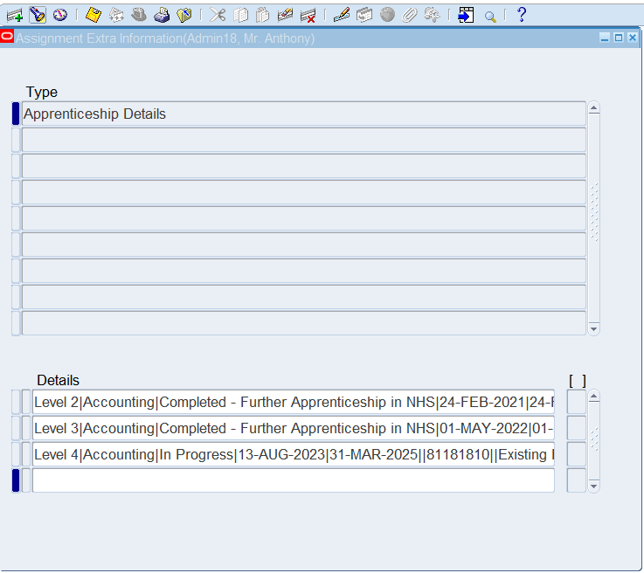
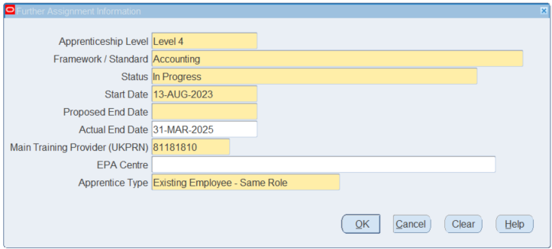
₅
EIT Form
If you need to record more than one Apprenticeship against an employee record, click into the next blank field in the Details area and complete the EIT form as appropriate.

Slide 6
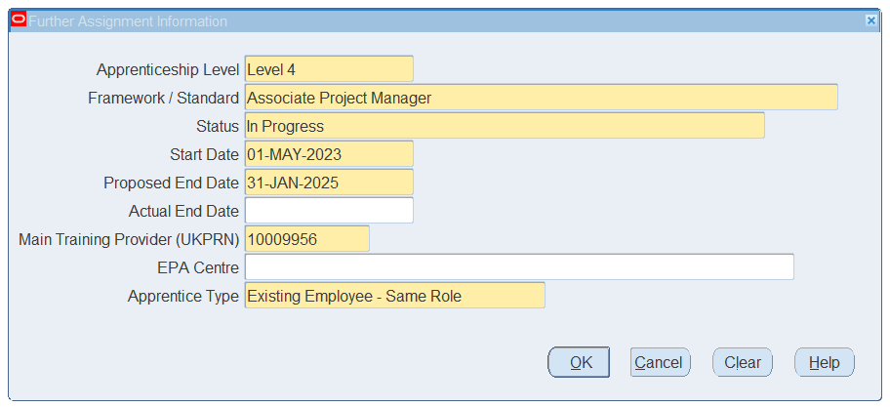
₆
Extra Information Type (EIT) Form
1
2
Framework/Standard
This list of values is updated as new Standards are developed.
2. Status – select one:
In Progress
Complete (Reason)
Discontinued (Reason)
Break in Learning
3. Main Training Provider
The UKPRN is a numerical identifier of the Training Provider.
4. EPA (End Point Assessment) Centre should be added as soon as the information is confirmed.
5. Apprentice Type – select one:
Existing Employee (New / Same Role)
New Employee
3
4
5
All the fields in this form can be updated/amended as required.

Slide 7
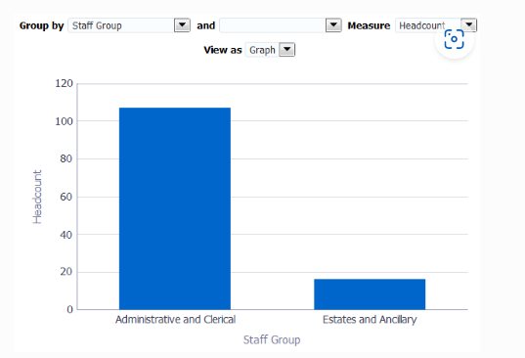
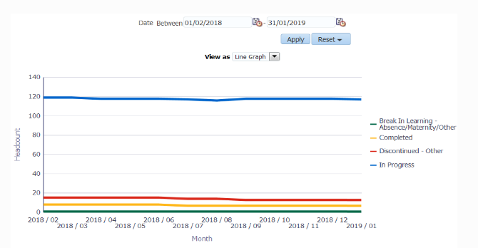
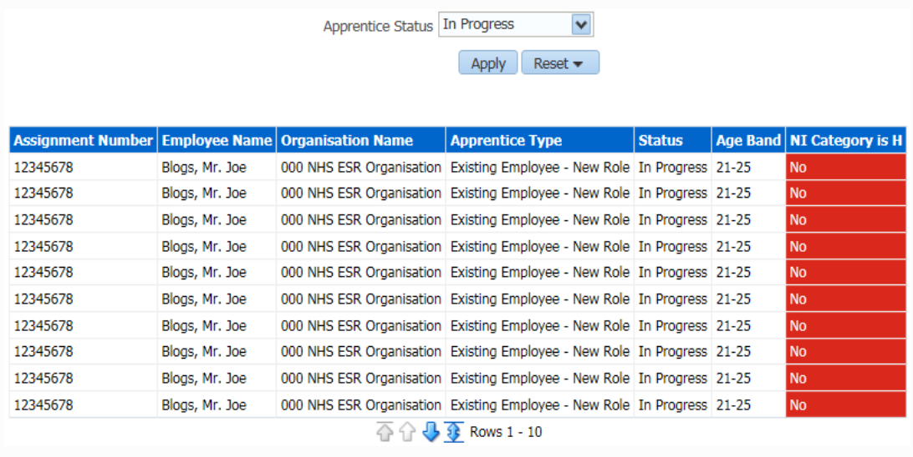
₇
Reporting
Learning Administration Dashboard Apprenticeships Summary
Apprenticeships Trending Dashboard
Staff in Post Dashboard
In Progress Apprentices NI Category RAG Status
Shows the percentage of employees undertaking Apprenticeships grouped by Staff Group.
Shows the number of Apprenticeships monthly as at the last day of the month.
This analysis is designed to highlight green where an employee’s NI Category is H and age is less than 25 years, and red where NI Category is not H (or is NULL) and age is less than 25.
Apprenticeships Detail
Details of the reports available can be found in the ESR BI Guide to Apprenticeships Summary and Apprenticeships Detail.

